Slide 1
Synthesis and Characterization of N-Doped Carbon Nanoribbons
John Glauber
Miguel Angel Ibarra
Michael Kummer
Advisor: Jessica Campos-Delgado

Slide 2
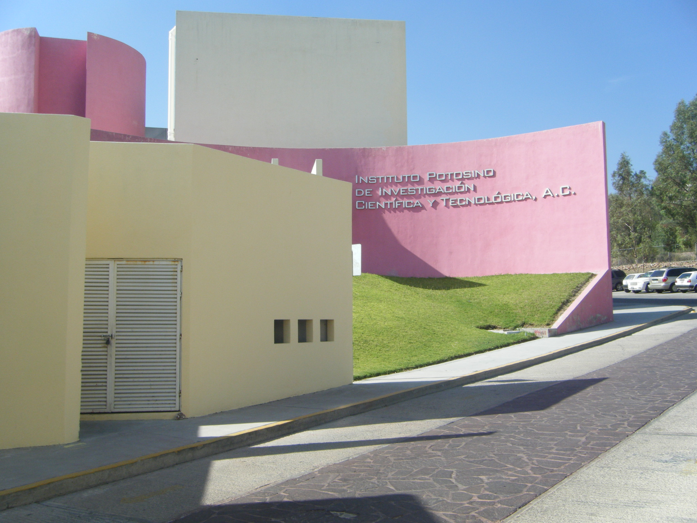

Slide 3
Purpose
To alter the physical and electrical properties of carbon nanoribbons by CVD.
To detect substitutional doping in the carbon lattice or at the edges with the use of:
Raman Spectroscopy
XRD
EDX

Slide 4
Review of Literature: Carbon Nanoribbons
Kosynkin, Dmitry V. et al. (2009)
Unzipping by solution oxidation
Suspend MWCNTs in H₂SO₄ and treated with KMnO₄
80-100% of MWCNTs form nanoribbons
Higher degrees of oxidation with more oxidizing agents
Computer rendering of the unzipping of a single layer of a MWCNT. Kosynkin, Dmitry V. et al.

Slide 5
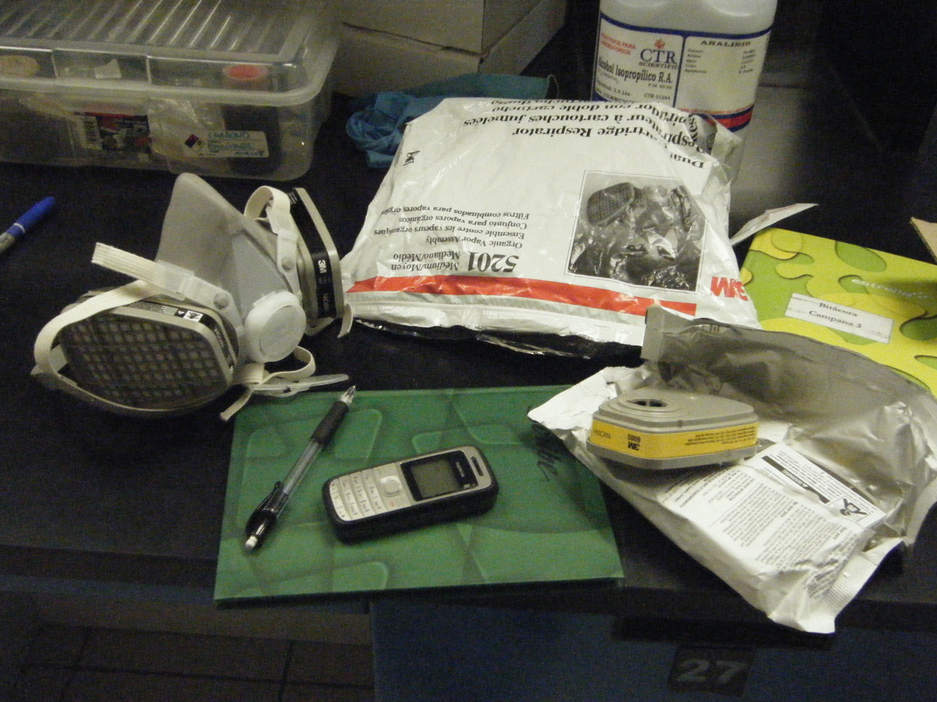

Slide 6
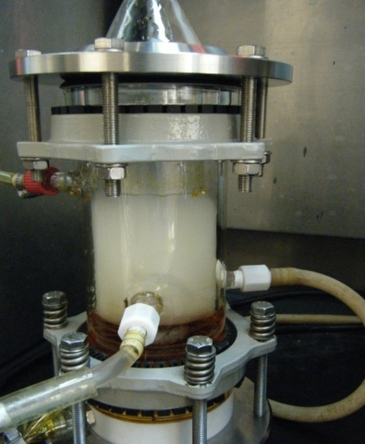
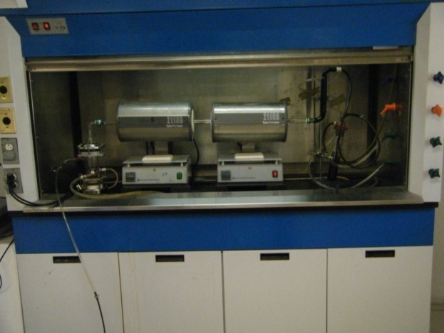
Method
Chemical Vapor Deposition Pyrolysis
Solution Preparation:
280 ml (98.625 wt%) Ethanol
2.8035 g (1.25 wt%) Ferrocene
266 µL (0.125 wt%) Thiophene
Furnace Temperature:
950°C
Flux Rates:
Heat/Cool: 0.2 L/min
Synthesis: 0.8 L/min
Ultrasonic Generator:
Wavelength: 590
Frequency: 568
Synthesis Duration:
30min

Slide 9
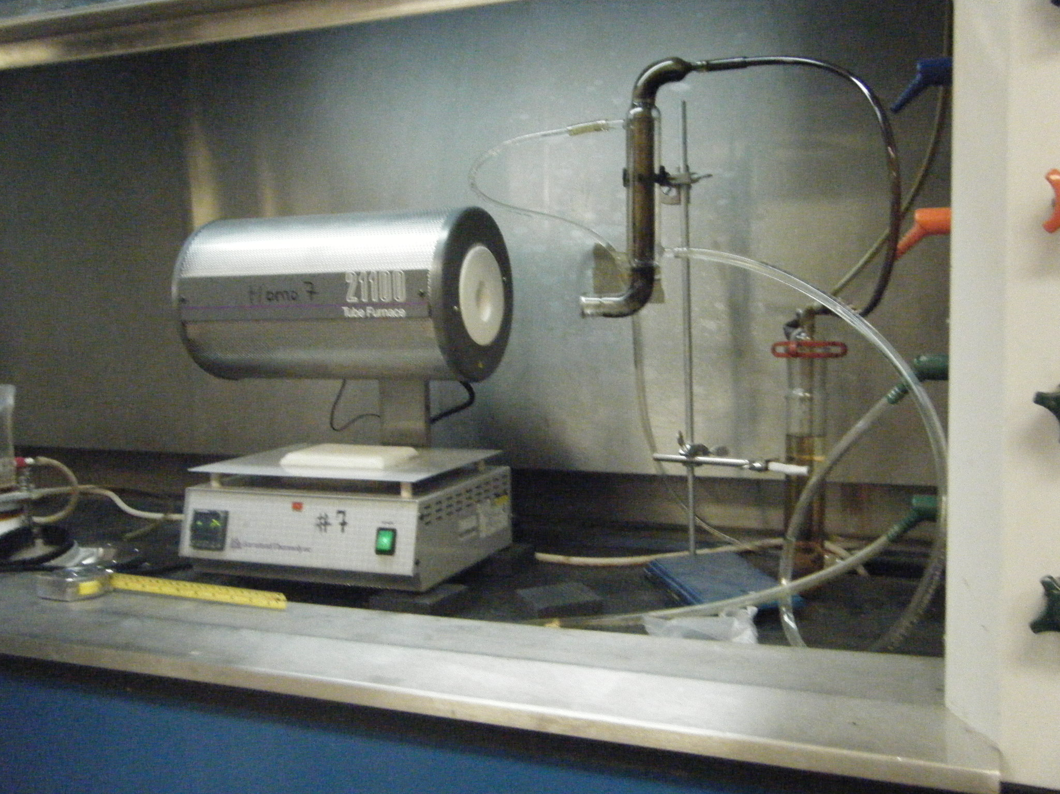

Slide 10
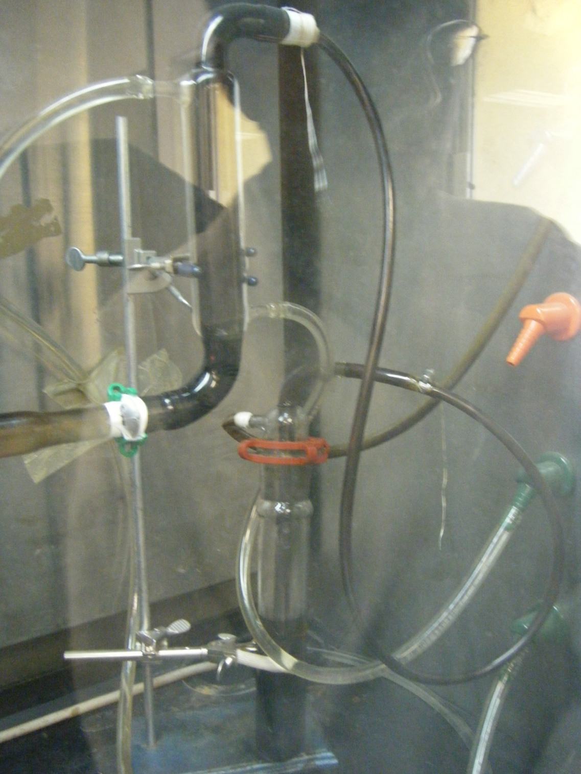

Slide 11
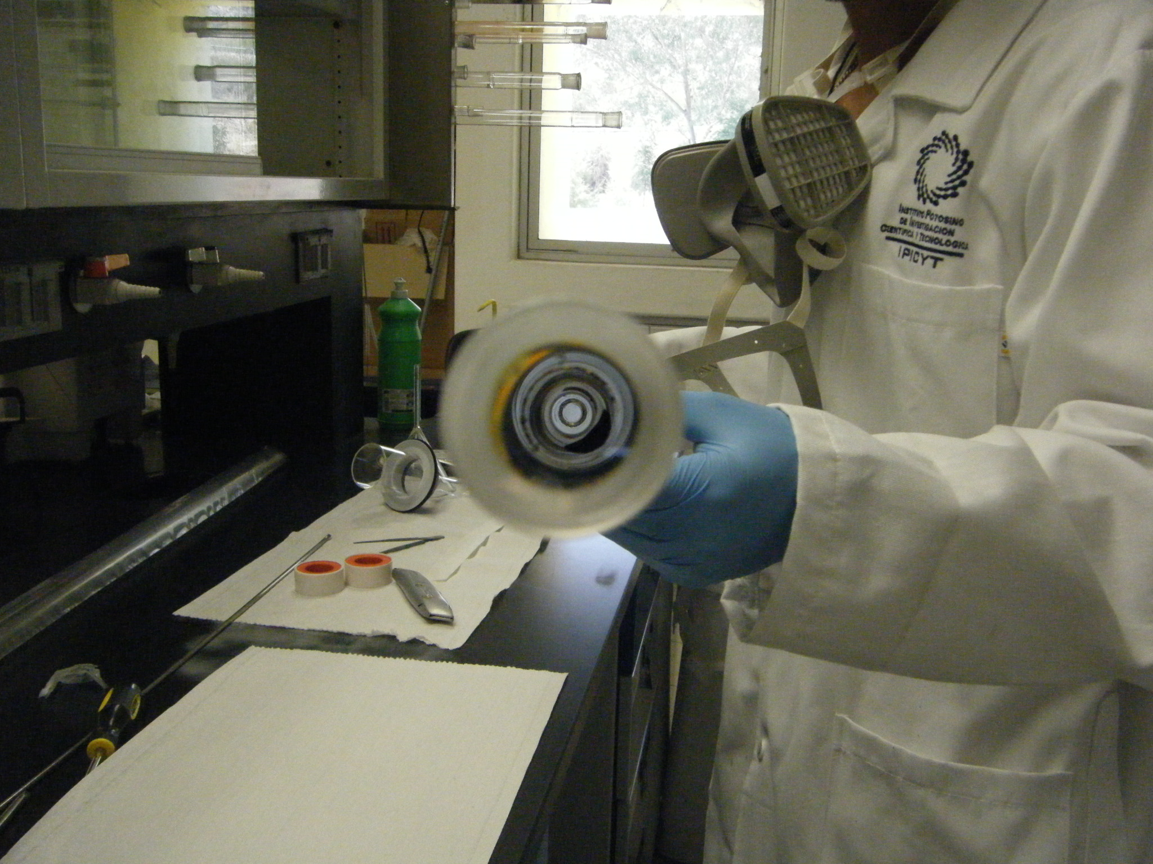

Slide 12
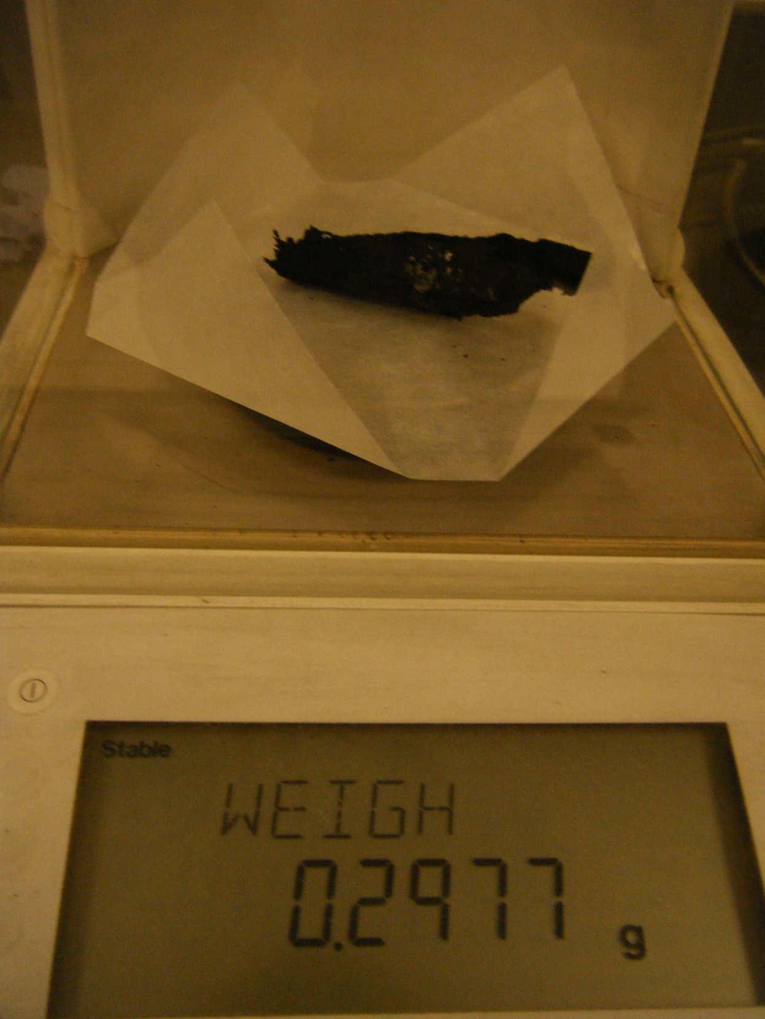

Slide 13
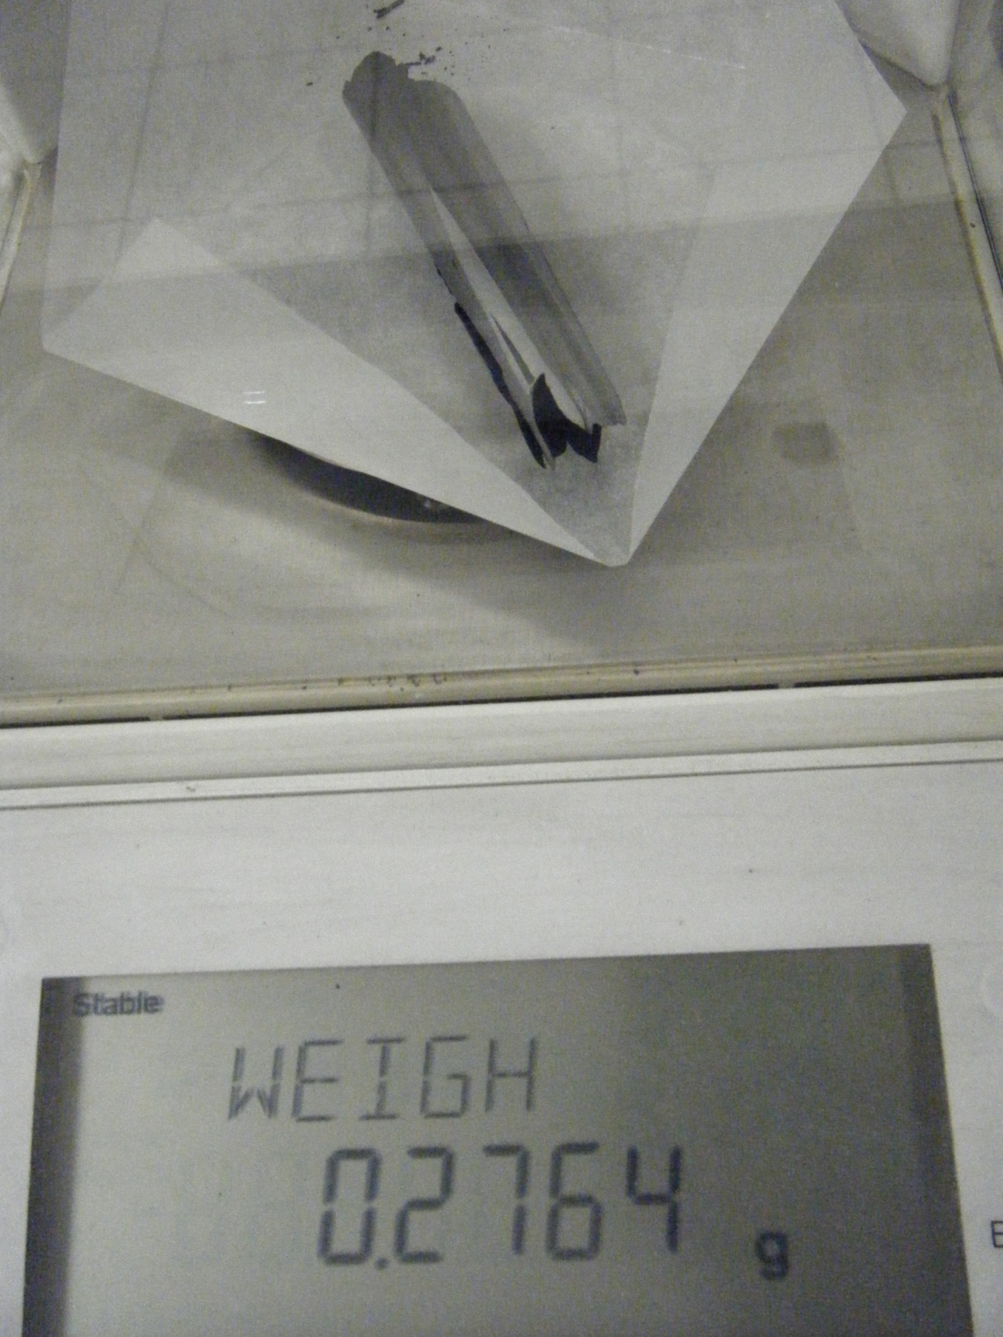

Slide 14
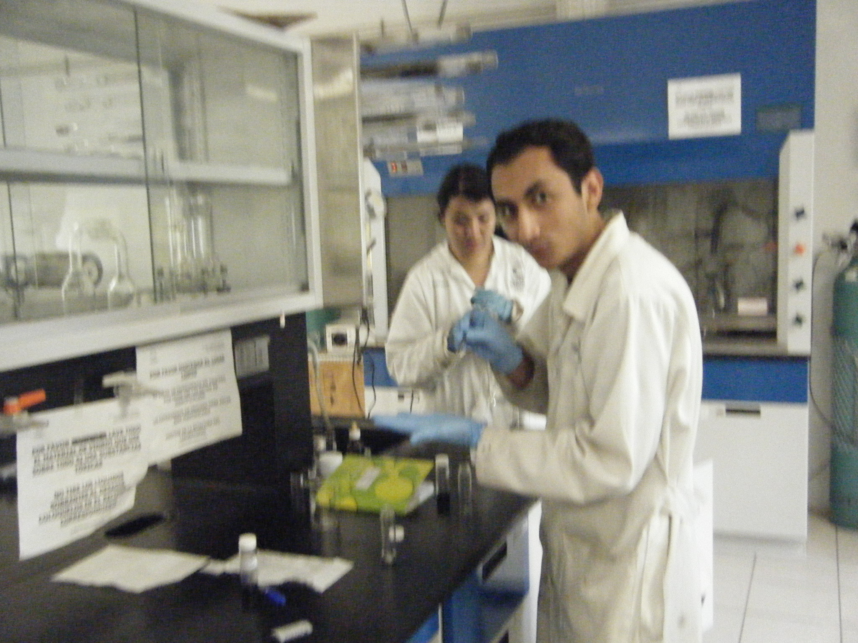

Slide 15
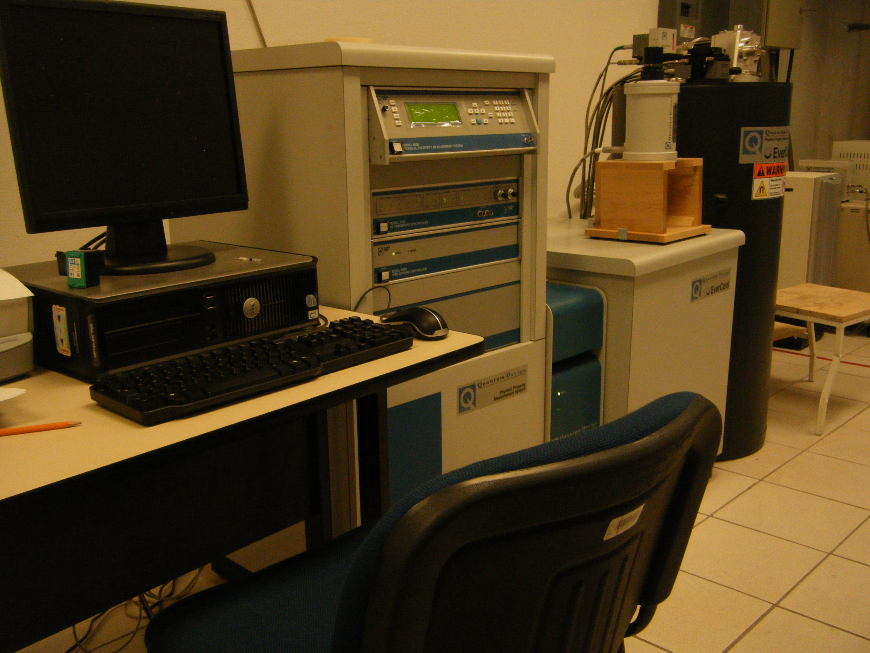

Slide 16
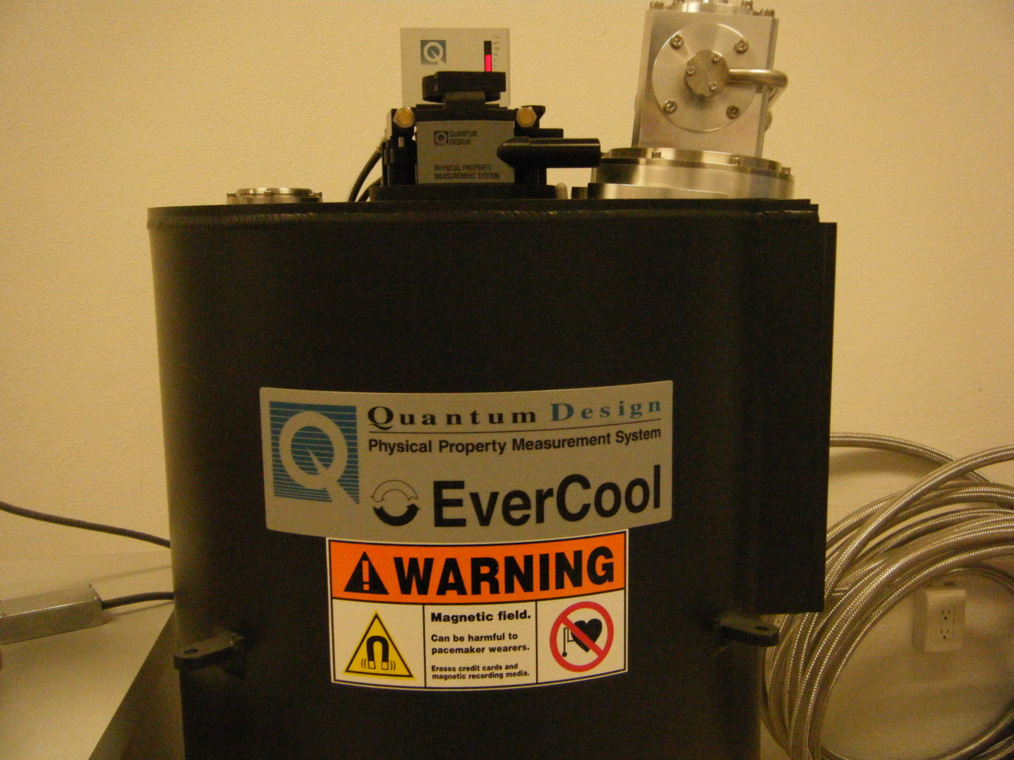

Slide 17
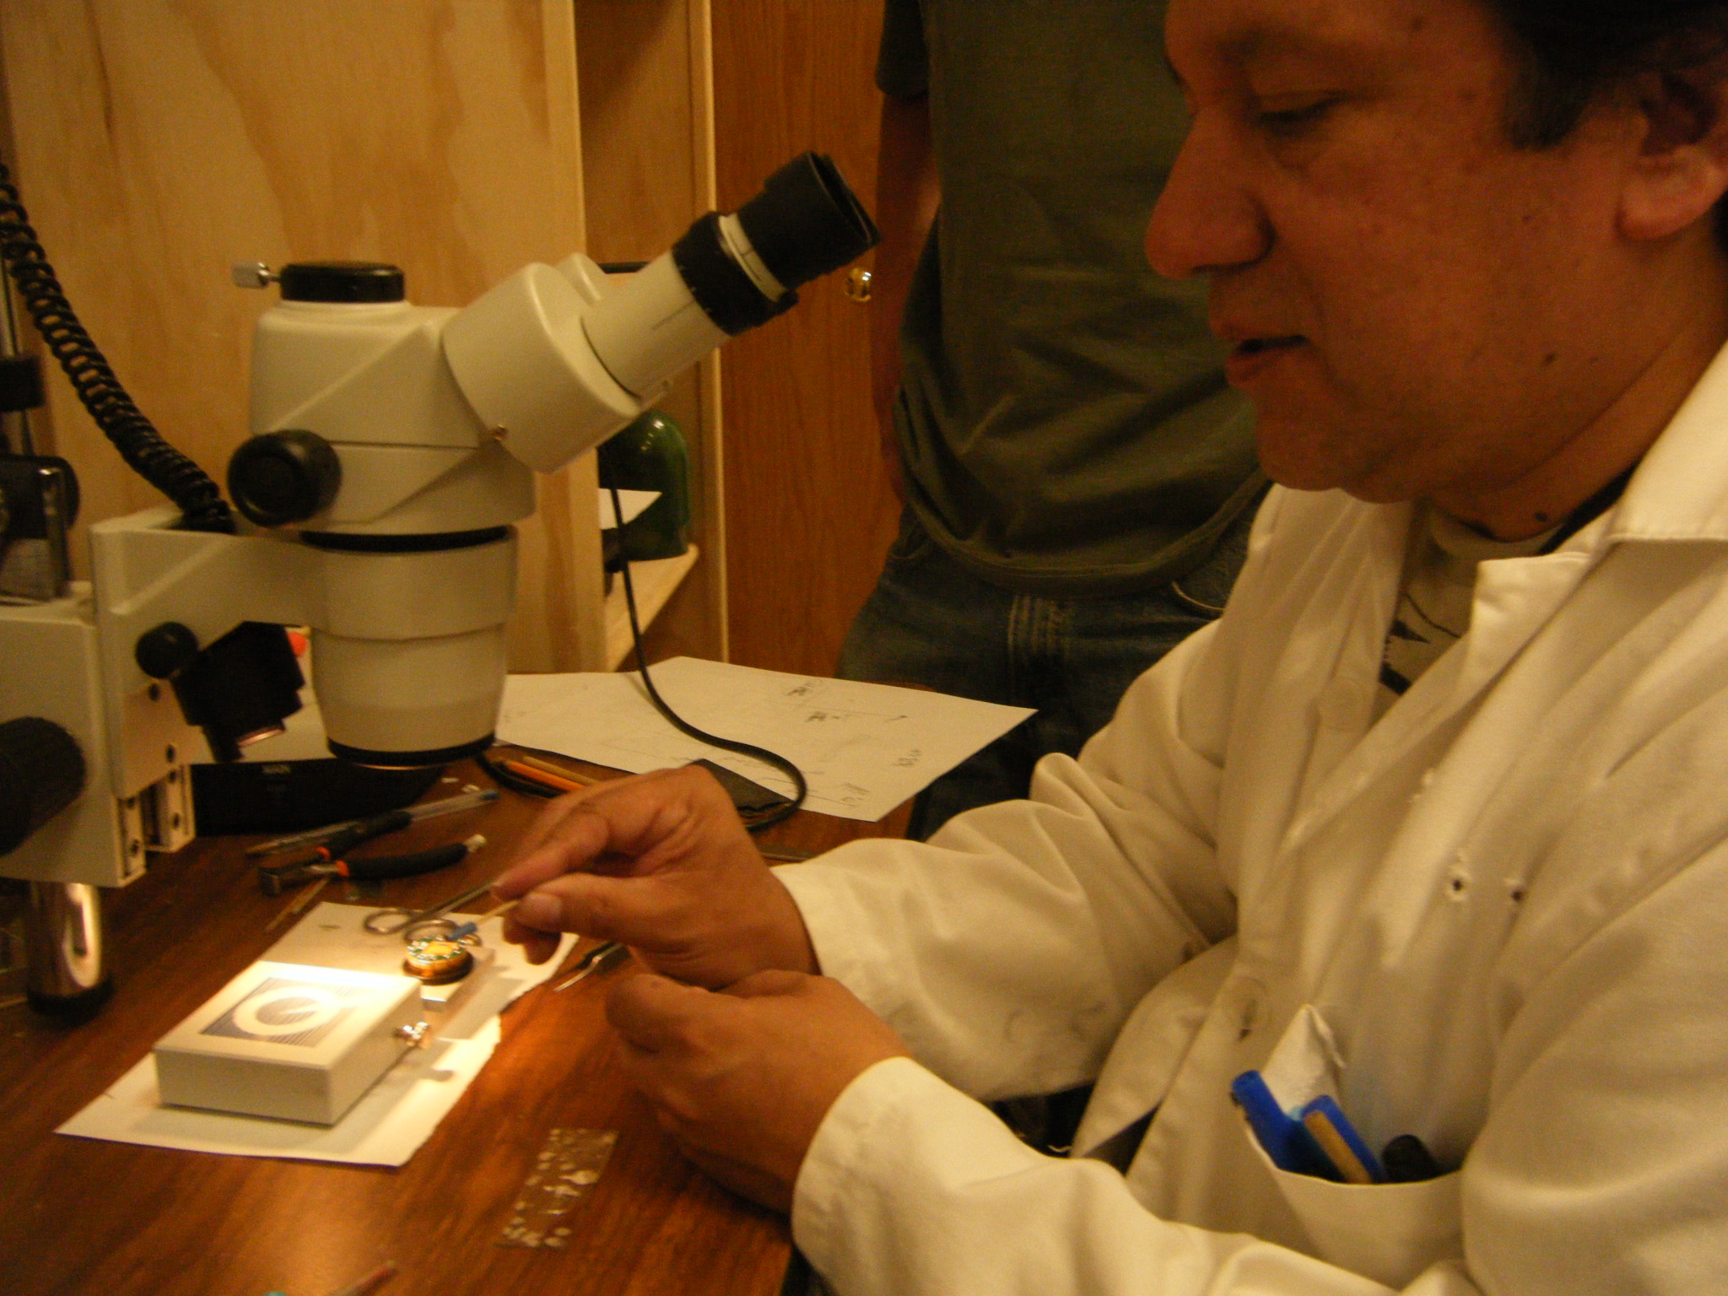

Slide 18
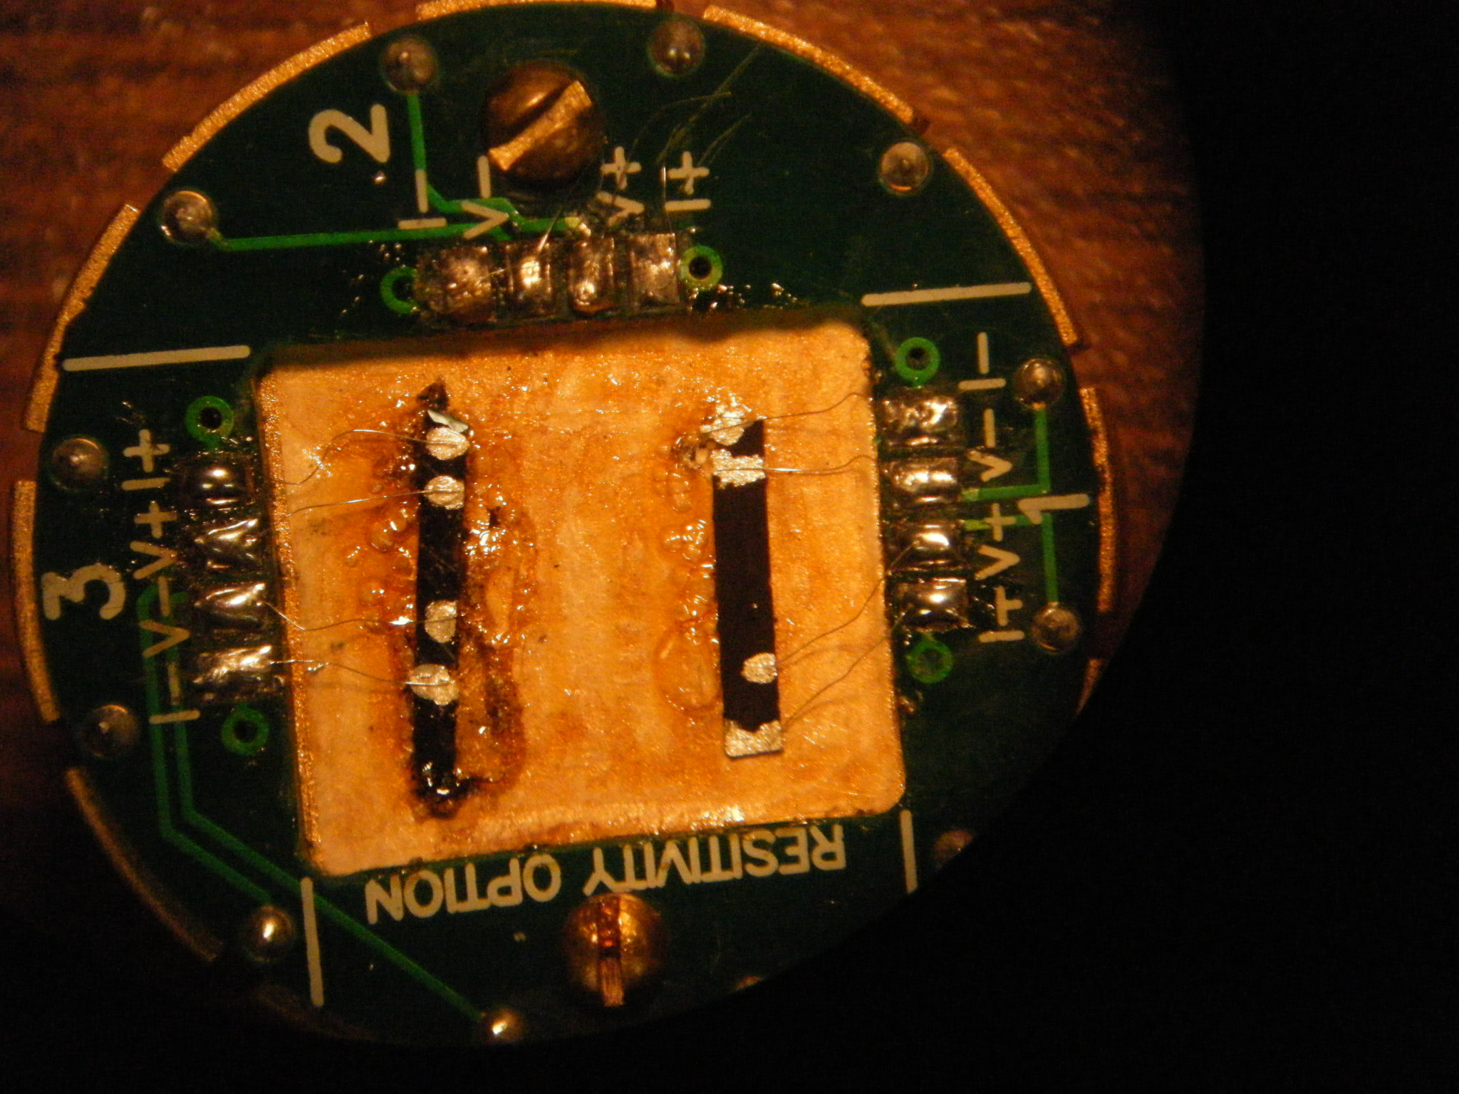

Slide 19
SEM Characterization
SEM images of pristine carbon nanoribbons synthesized by the CVD pyrolysis process

Slide 20
Evidence of fiber and tube growth in pristine carbon nanoribbon sample.

Slide 21
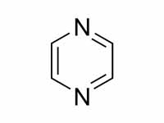
Method of Production: In-Situ N-Doped nanoribbons
Pyrazine (C₄H₄N₂)
Pyrazine Concentration (wt %) | 0.125 | 1 | 3
Ferrocene Concentration (wt %) | 1.25 | 1.25 | 1.25
Thiophene Concentration (wt %) | 0.125 | 0.125 | 0.125
Furnace Temperature (°C) | 950 | 950 | 950
Synthesis Duration (min) | 30 | 30 | 30
Argon Flux Rates (L/min) | Purge: 0.2 L/min Synthesis: 0.8 L/min | Purge: 0.2 L/min Synthesis: 0.8 L/min | Purge: 0.2 L/min Synthesis: 0.8 L/min

Slide 22
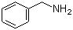
Method of Production: In-Situ N-Doped nanoribbons
Benzylamine (C₇H₉N)
Benzylamine Concentration (wt %) | 3 | 5 | 10
Ferrocene Concentration (wt %) | 1.25 | 1.25 | 1.25
Thiophene Concentration (wt %) | 0.125 | 0.125 | 0.125
Furnace Temperature (°C) | 950 | 950 | 950
Synthesis Duration (min) | 30 | 30 | 30
Argon Flux Rates (L/min) | Purge: 0.2 L/min Synthesis: 0.8 L/min | Purge: 0.2 L/min Synthesis: 0.8 L/min | Purge: 0.2 L/min Synthesis: 0.8 L/min

Slide 23
Characterization Methods
SEM
TEM
XRD
Raman
PPMS

Slide 24
SEM
0.125% Pyrazine; 1.0% Pyrazine; 3.0% Pyrazine

Slide 25
0.125 wt% Pyrazine
SEM images of carbon nanoribbons doped with 0.125 wt% pyrazine.

Slide 26
1.0 wt% Pyrazine
SEM images of carbon nanoribbons doped with 1.0 wt% pyrazine. Higher concentrations of worm and tube growth are apparent.

Slide 27
3.0 wt% Pyrazine
SEM images of carbon nanoribbons doped with 3.0 wt% pyrazine. Higher concentrations of tube and fiber growth are apparent.

Slide 28
SEM
3.0 wt% Benzylamine, 5.0 wt% Benzylamine, 10.0 wt% Benzylamine

Slide 29
3.0 wt% Benzylamine
SEM images of carbon nanoribbons doped with 3.0 wt% benzylamine.

Slide 30
5.0 wt% Benzylamine
SEM images of carbon nanoribbons doped with 5.0 wt% benzylamine. Evidence of carbonaceous growth can be detected.

Slide 31
5.0% Benzylamine EDX distribution of number of counts as a function of energy (eV). No evidence of nitrogen was detected. XL-30 SEM was used to collect data.

Slide 32
10.0 wt% Benzylamine
SEM images of carbon nanoribbons doped with 10.0 wt% benzylamine. Evidence of fibers and carbonaceous growth can be detected.

Slide 33
TEM
3% Pyrazine

Slide 34
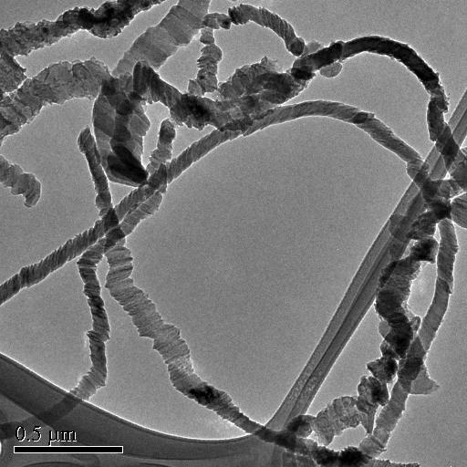
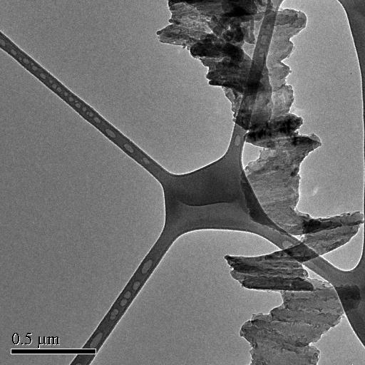
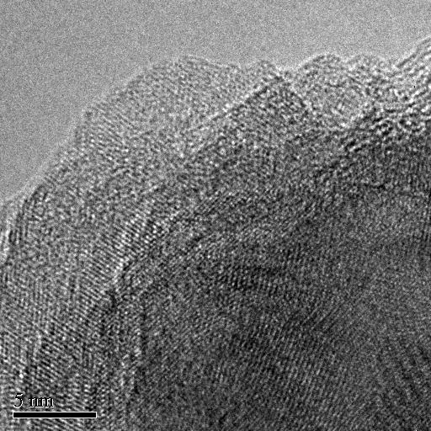
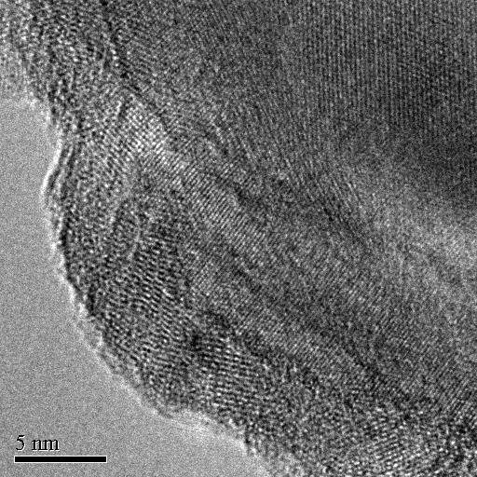
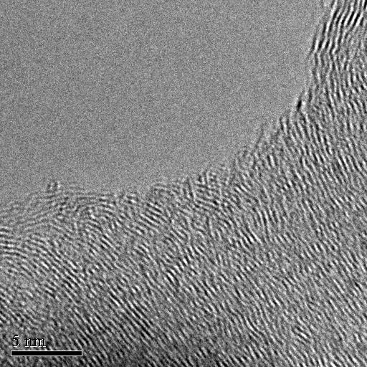
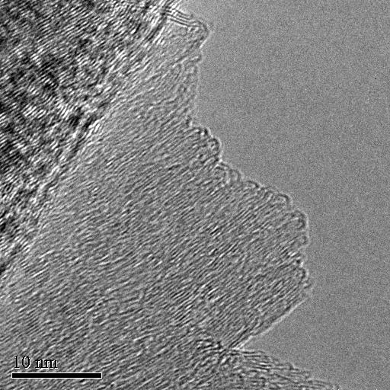

Slide 35
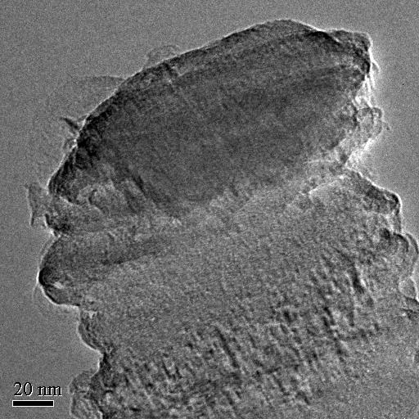
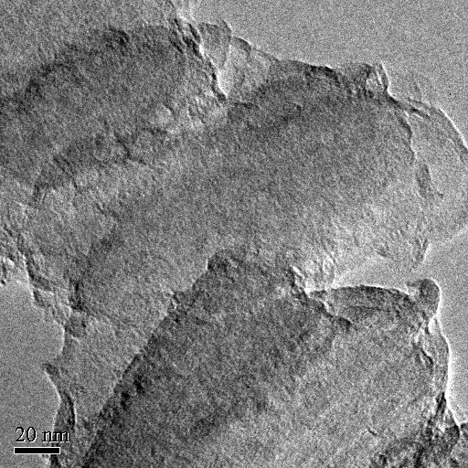
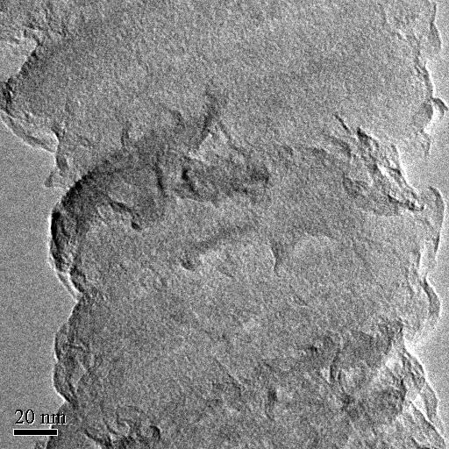
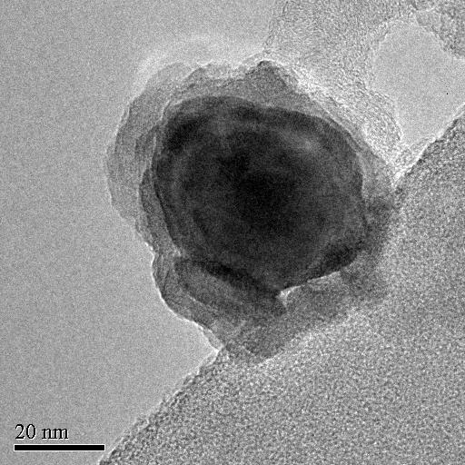
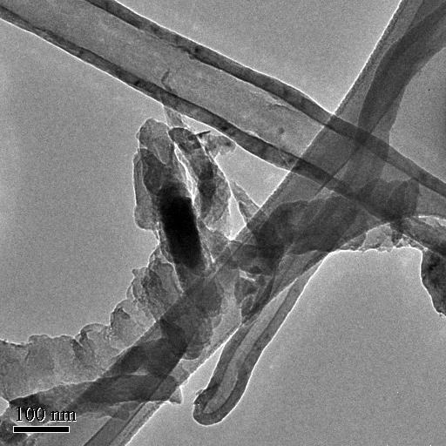
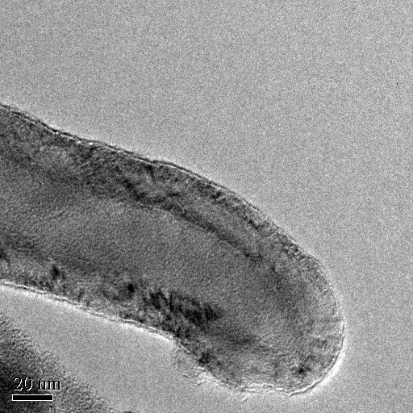

Slide 36
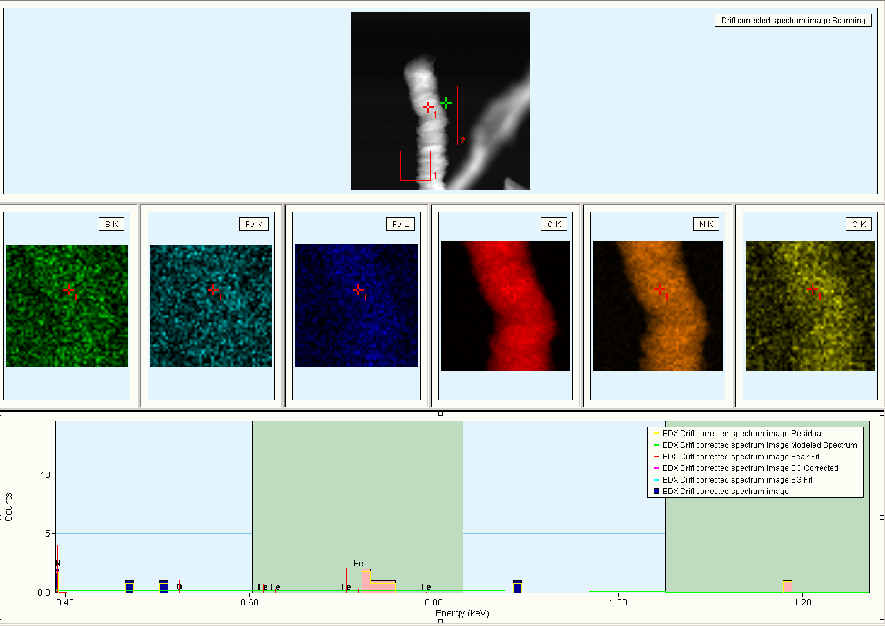
EDX Line Scan of 3% Pyrazine

Slide 37
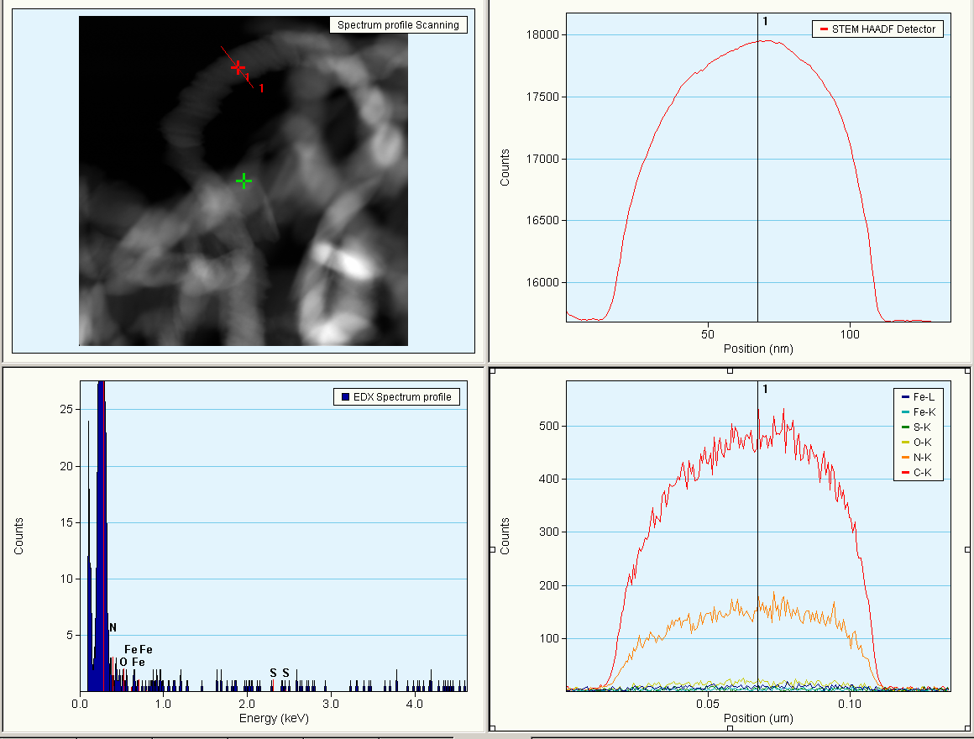
EDX Line Scan of 3% Pyrazine

Slide 38
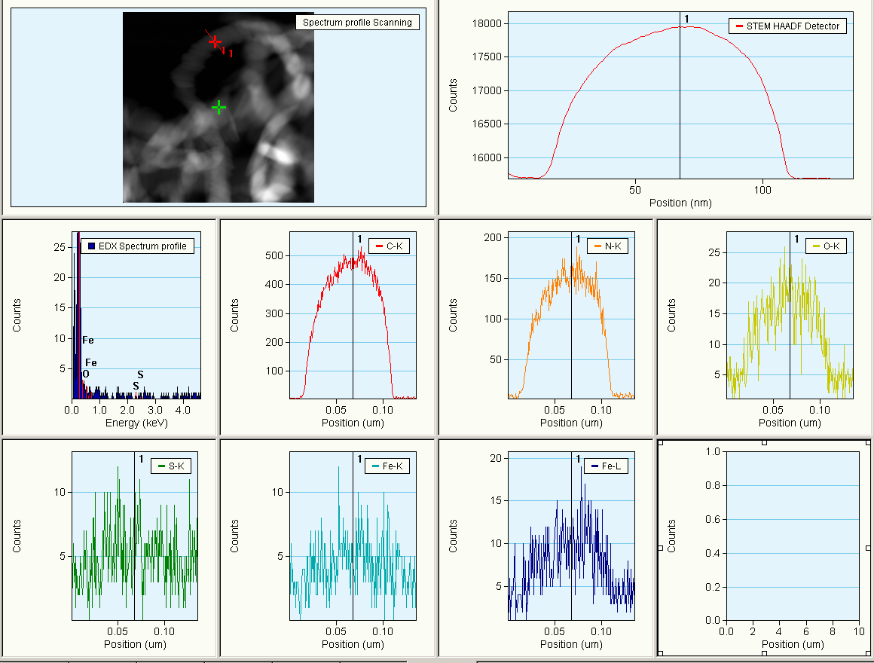
EDX Line Scan of 3% Pyrazine

Slide 39
XRD
Pristine; 0.125%, 1.0%, 3.0% Pyrazine; 3.0%, 5.0%, 10.0% Benzylamine

Slide 40
Bragg’s Law: nλ=2d sin(θ)
Normalized graphs of intensity as a function of angle for x-ray diffraction with pristine and nitrogen doped carbon nanoribbons. The graph on the right shows a close up of the 002 peak.

Slide 41
Spacing Between Graphitic Planes
Sample | d spacing (Å)
Pristine | 3.400
Pyrazine 0.125% | 3.393
Pyrazine 1.0% | 3.381
Pyrazine 3.0% | 3.375
Benzylamine 3.0% | 3.392
Benzylamine 5.0% | 3.383
Benzylamine 10.0% | 3.381
NOTE: All d spacing values were determined by averaging data from the first and second order peaks. The wavelength of the x-rays was 1.54 Å.

Slide 42
Raman
Pristine; 0.125% Pyrazine; 1.0% Pyrazine; 3.0% Pyrazine; 3.0% Benzylamine; 5.0% Benzylamine

Slide 45
D and G Band Intensity Ratio
Sample | I_{D}/I_{G}
Pristine | 0.897
Pyrazine 0.125% | 1.061
Pyrazine 1.0% | 0.872
Pyrazine 3.0% | 1.057
Benzylamine 3.0% | 0.960
Benzylaminne 5.0% | 0.914

Slide 46
PPMS
Pristine

Slide 47
Resistivity as a function of magnetic field for the dark side of a pristine carbon nanoribbons.
Resistivity as a function of magnetic field for the shiny side of a pristine carbon nanoribbons.
Resistivity as a function of temperature for the dark side of a pristine carbon nanoribbons.
Resistivity as a function of temperature for the shiny side of a pristine carbon nanoribbons.

Slide 48
Future Work
Conduct further trials to determine ideal concentration for doping
Additional characterization to search for evidence of N-doping
Electron Diffraction
Thermogravimetric Analysis (TGA)
X-ray Photoelectron Spectroscopy (XPS)
Electron Energy Loss Spectroscopy (EELS)

Slide 49
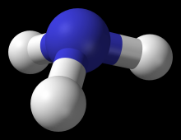
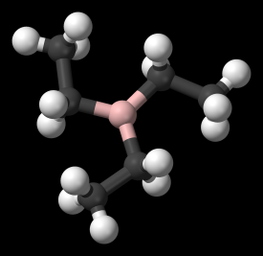
Future Work
Post synthesis treatment:
Ammonia (NH₃)
Boron Doping:
TEB

Slide 50
SEM
0.125 wt% Triethylborane, 1.0 wt% Triethylborane

Slide 51
0.125 wt% Triethylborane
SEM images of carbon nanoribbons doped with 0.125 wt% triethylborane.

Slide 52
0.125 wt% Triethylborane
SEM images of carbon nanoribbons doped with 0.125 wt% triethylborane.

Slide 53
0.125 wt% Triethylborane
SEM images of carbon nanoribbons doped with 0.125 wt% triethylborane. Evidence of tube and fiber growth.

Slide 54
1.0 wt% Triethylborane
SEM images of carbon nanoribbons doped with 1.0 wt% triethylborane.

Slide 55
1.0 wt% Triethylborane
SEM images of carbon nanoribbons doped with 1.0 wt% triethylborane.

Slide 56


Acknowledgements
Prof. M. Terrones; Prof. H. Terrones; Prof. P. Ajayan; Prof. E. Muñoz; D. Ramirez; H. Martínez; S. Vega; A. Morelos; V. Gonzalez; A. Botello; Rice University; IPICYT

Slide 57
Works Cited
Hongjie Dai et al. “Chemically Derived, Ultrasmooth Graphene Nanoribbon Semiconductors.” Science 29 Feb 2008: vol. 19, 1229-1231
Jiao, Liying et al. “Narrow graphene nanoribbons from carbon nanotubes.” Nature 16 April 2009: vol. 458, 877-880
Cano-Márquez, Abraham G. et al. “Ex-MWNTs: Graphene Sheets and Ribbons Produced by Lithium Intercalation and Exfoliation of Carbon Nanotubes” Nano Letters 2009: vol. 9, no. 4, 1527-1533
Kosynkin, Dmitry V. et al. “Longitudinal unzipping of carbon nanotubes to form graphene nanoribbons” Nature 16 April 2009: vol. 458, 872-876
Murayama, H. and T. Maeda “A novel form of filamentous graphite” Nature 28 June 1990: vol. 345, 791-793
Wei, Dacheng et al. “Synthesis of N-Doped Graphene by Chemical Vapor Deposition and its Electrical Properties” Nano Letters 2009: Vol. 9. no. 5, 1752-1758
Wang, Xinran et al. “N-doping of Graphene through Electrochemical Reactions with Ammonia” Science 8 May 2009: Vol. 324. no. 5928, 768 - 771

Slide 58
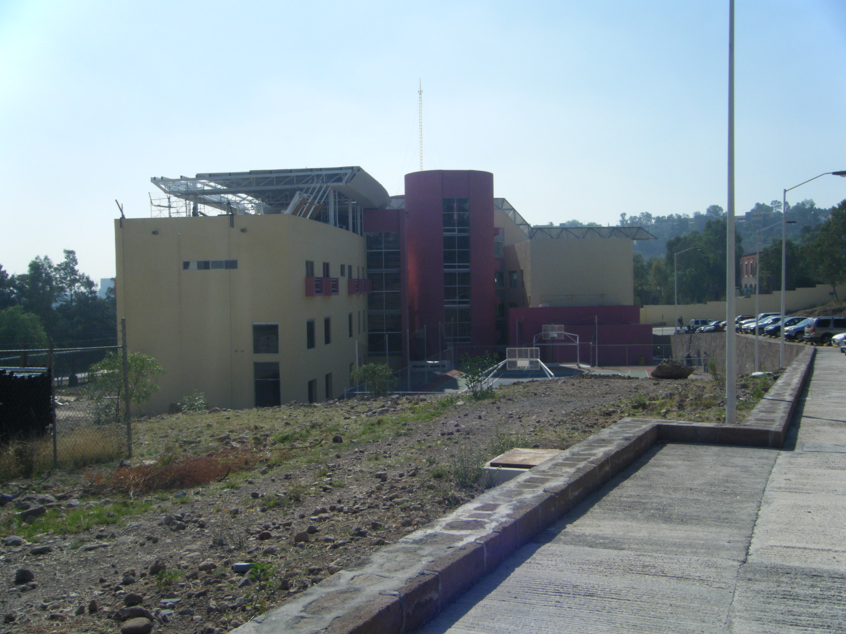

Slide 59
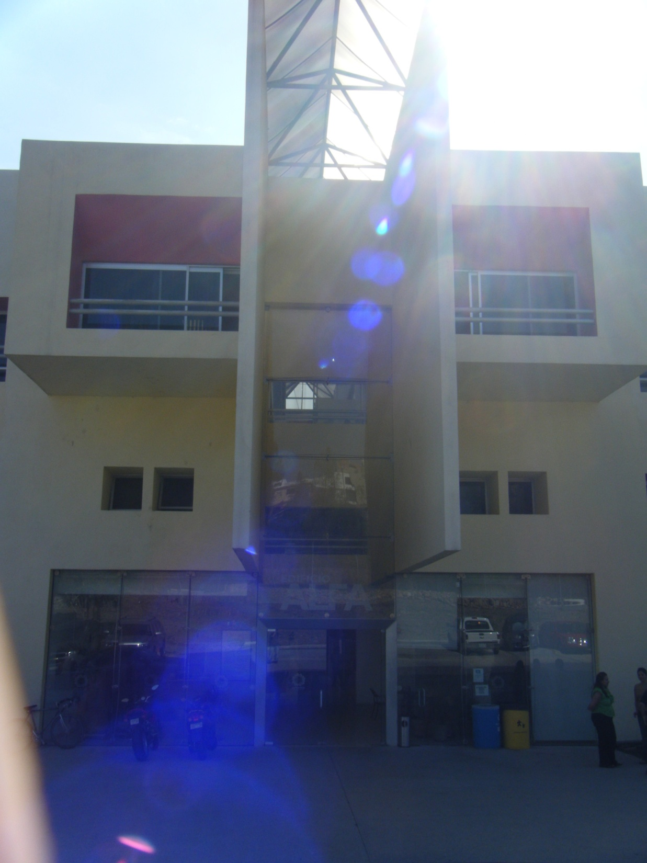

Slide 60
